Slide 1

999
START
Options
Shop
Exit

Slide 2
Level
999

Slide 3
Options
Options
Music
SFX
NightMode

Slide 4




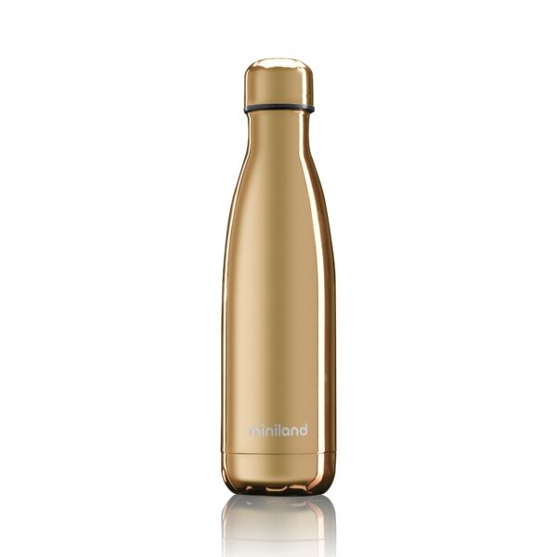
Shop
999
100
100
100
100
5000

